Slide 1

6th Grade Accelerated Math
Unit 9, Lesson 8 Comparing Distributions Volume 2, pg. 83

Slide 2


Benchmarks
MA.6.DP.1.2
Given a numerical data set within a real-world context, find and interpret mean, median, mode, and range.
MA.6.DP.1.4
Given a histogram or line plot within a real-world context, qualitatively describe and interpret the spread and distribution of the data, including any symmetry, skewness, gaps, clusters, outliers, and the range.
volume 2, pg. 83

Slide 3
Integrated Mathematical Thinking and Reasoning Standards
MA.K12.MTR.2.1 Demonstrate understanding by representing problems in multiple ways.
MA.K12.MTR.4.1 Engage in discussions that reflect on the mathematical thinking of self and others.
MA.K12.MTR.6.1 Assess the reasonableness of solutions.
MA.K12.MTR.7.1 Apply mathematics to real-world contexts.
volume 2, pg. 83

Slide 4

Learning Targets
I can find and interpret the mean and median of data sets.
I can use mean and median to compare data sets.
I can compare the distribution of data sets.
volume 2, pg. 83

Slide 5

Warm-Up
volume 2, pg. 84

Slide 6
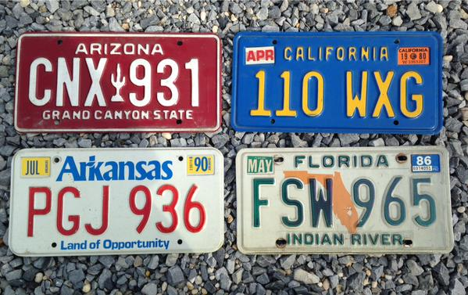
9.8.1 Warm-Up: Which One Doesn’t Belong?
Which license plate doesn’t belong? Explain your reasoning.
volume 2, pg. 84

Slide 7

Collaboration
volume 2, pg. 84

Slide 8

9.8.2 Collaboration: Comparing Distributions
Clare recorded the amount of time students in the sixth, eighth, and tenth grades spent doing homework, in hours per week. She made a line plot of the data for each grade and provided the following summary.
Students in sixth grade tend to spend less time on homework than students in eighth and tenth grades.
The homework times for the tenth-grade students are more alike than the homework times for the eighth-grade students.
volume 2, pg. 84

Slide 9
Use Clare's summary to match each line plot to the correct grade (sixth, eighth, or tenth).
Grade Level | Line Plot
volume 2, pg. 84

Slide 10
Grade Level | Line Plot
 | Time (in hours)
volume 2, pg. 84

Slide 11

Guided Practice
volume 2, pg. 85

Slide 12

9.8.3 Guided Practice: Comparing Distributions
A histogram and line plot of the number of goals scored by the top 15 women goal scorers during the 2019‑2020 NCAA Women’s Division 1 soccer season are shown.
2019-2020 NCAA Women’s Division 1 Soccer Top Scorers
Frequency
Number of Goals
volume 2, pg. 85

Slide 13
Number of Goals
histogram
line plot
histogram and line plot
The can be used to determine the mean.
The can be used to determine the median.
histogram
line plot
histogram and line plot
volume 2, pg. 85

Slide 14
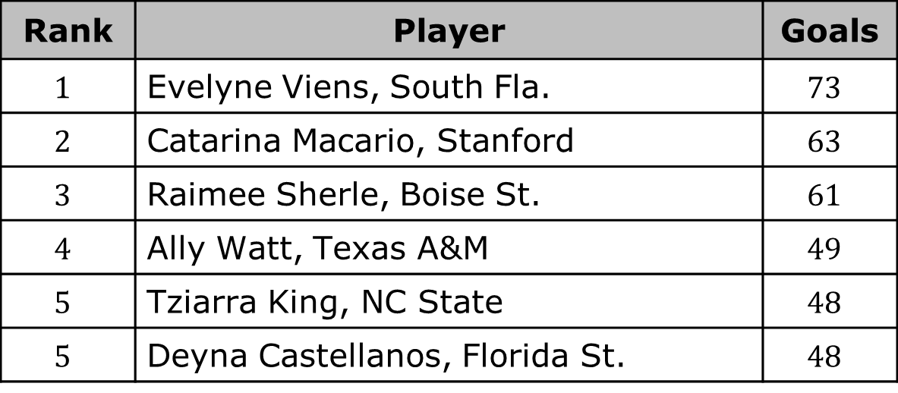
Which measure of central tendency do you expect to be larger, the mean or the median? Explain your reasoning.
The table lists the data for the top 15 women goal scorers during the 2019-2020 NCAA Women’s Division 1 soccer season.
Rank | Player | Goals
$$1$$ | Evelyne Viens, South Fla. | $$73$$
$$2$$ | Catarina Macario, Stanford | $$63$$
$$3$$ | Raimee Sherle, Boise St. | $$61$$
$$4$$ | Ally Watt, Texas A&M | $$49$$
$$5$$ | Tziarra King, NC State | $$48$$
$$5$$ | Deyna Castellanos, Florida St. | $$48$$
volume 2, pg. 85

Slide 15
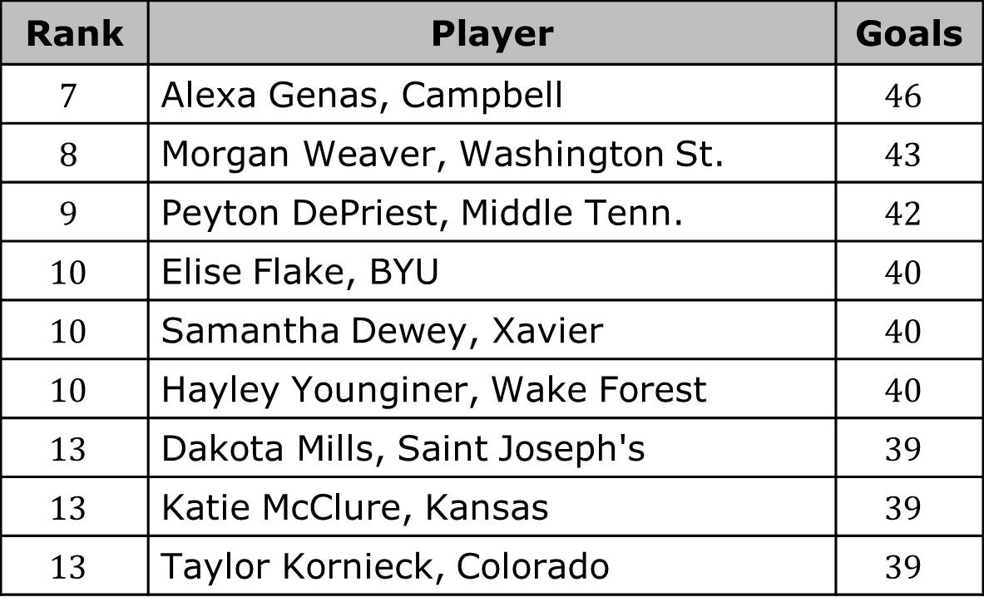
Rank | Player | Goals
$$7$$ | Alexa Genas, Campbell | $$46$$
$$8$$ | Morgan Weaver, Washington St. | $$43$$
$$9$$ | Peyton DePriest, Middle Tenn. | $$42$$
$$10$$ | Elise Flake, BYU | $$40$$
$$10$$ | Samantha Dewey, Xavier | $$40$$
$$10$$ | Hayley Younginer, Wake Forest | $$40$$
$$13$$ | Dakota Mills, Saint Joseph's | $$39$$
$$13$$ | Katie McClure, Kansas | $$39$$
$$13$$ | Taylor Kornieck, Colorado | $$39$$
Find the mean number of goals. Interpret the mean.
Find the median number of goals. Interpret the median.
volume 2, pg. 86

Slide 16
Which value is larger, the mean or the median?
How would the mean and median change if you found the mean goals and median goals for the top 8 scorers?
volume 2, pg. 86

Slide 17
Find the mean number of goals for the top 8 scorers.
Find the median number of goals for the top 8 scorers.
Discuss with your partner how the measures of central tendency changed. Write your conclusion.
volume 2, pg. 86

Slide 18

Your Turn
volume 2, pg. 87

Slide 19
9.8.4 Your Turn!
The line plots show the top 15 women goal scorers during the 2016-2017 and 2019-2020 NCAA Women’s Division 1 soccer season.
2016-2017 Season
2019-2020 Season
Number of Goals
volume 2, pg. 87

Slide 20
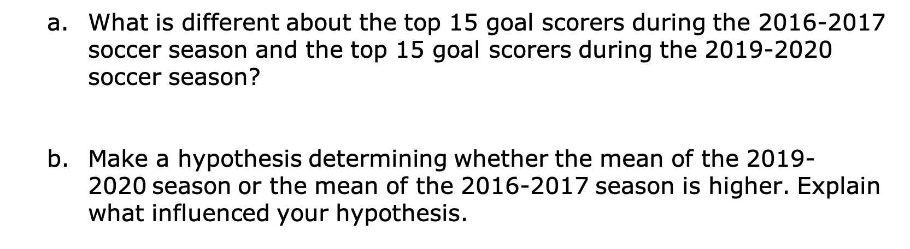
2016-2017 Season
2019-2020 Season
Number of Goals
What is different about the top 15 goal scorers during the 2016-2017 soccer season and the top 15 goal scorers during the 2019-2020 soccer season?
Make a hypothesis determining whether the mean of the 2019-2020 season or the mean of the 2016‑2017 season is higher. Explain what influenced your hypothesis.
volume 2, pg. 87

Slide 21
2016-2017 Season
2019-2020 Season
Number of Goals
Make a hypothesis determining whether the median of the 2019-2020 season or the median of the 2016-2017 season is higher. Explain what influenced your hypothesis.
Compare your predictions with your partner’s predictions. Make any adjustments needed based on your conversation.
volume 2, pg. 87

Slide 22
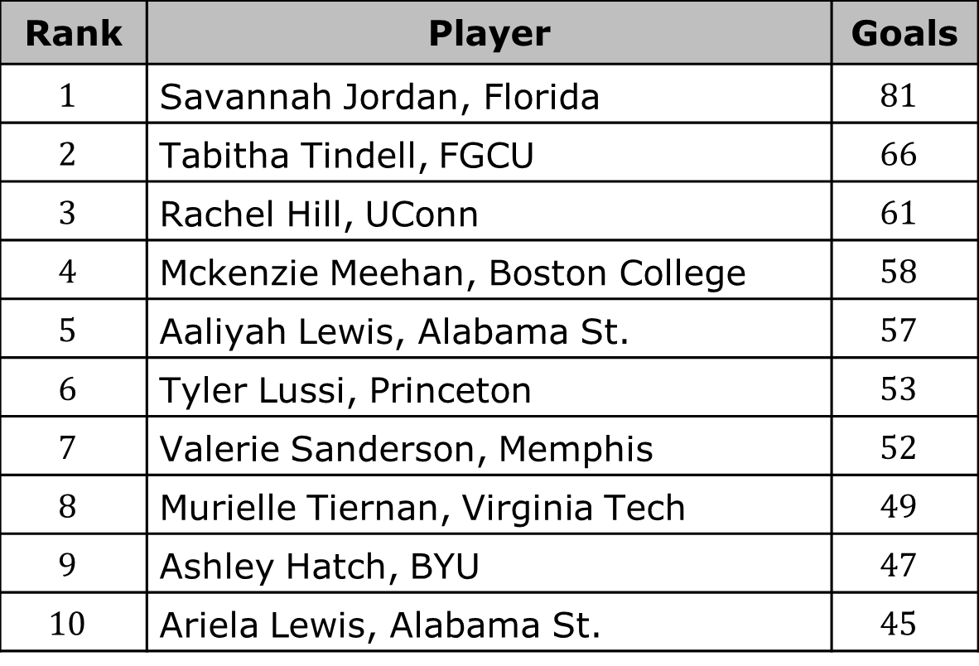
The table shows the list of the top 15 women goal scorers during the 2016-2017 NCAA Women’s Division 1 soccer season.
Rank | Player | Goals
$$1$$ | Savannah Jordan, Florida | $$81$$
$$2$$ | Tabitha Tindell, FGCU | $$66$$
$$3$$ | Rachel Hill, UConn | $$61$$
$$4$$ | Mckenzie Meehan, Boston College | $$58$$
$$5$$ | Aaliyah Lewis, Alabama St. | $$57$$
$$6$$ | Tyler Lussi, Princeton | $$53$$
$$7$$ | Valerie Sanderson, Memphis | $$52$$
$$8$$ | Murielle Tiernan, Virginia Tech | $$49$$
$$9$$ | Ashley Hatch, BYU | $$47$$
$$10$$ | Ariela Lewis, Alabama St. | $$45$$
volume 2, pg. 88

Slide 23
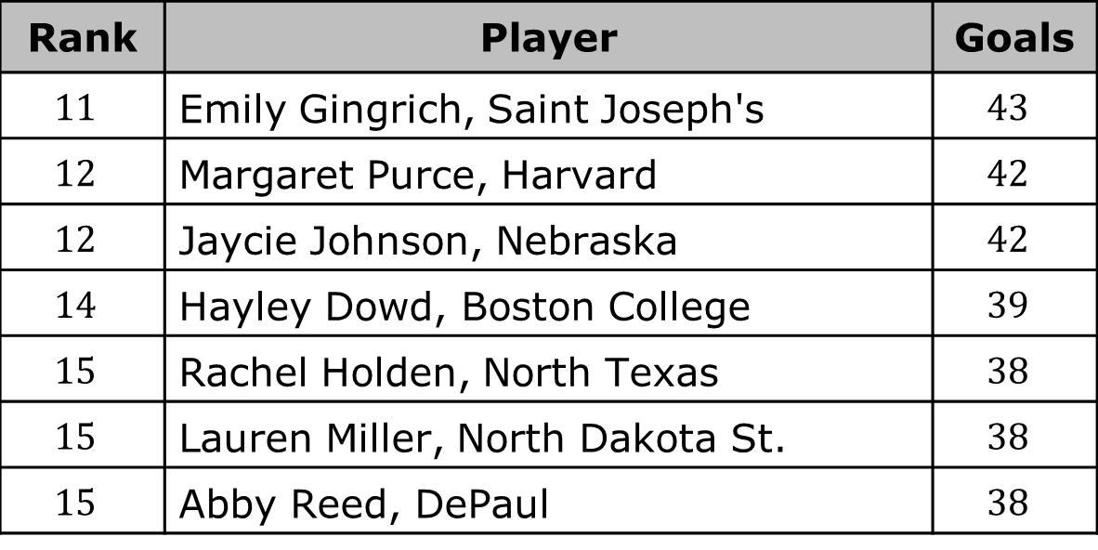
Rank | Player | Goals
$$11$$ | Emily Gingrich, Saint Joseph's | $$43$$
$$12$$ | Margaret Purce, Harvard | $$42$$
$$12$$ | Jaycie Johnson, Nebraska | $$42$$
$$14$$ | Hayley Dowd, Boston College | $$39$$
$$15$$ | Rachel Holden, North Texas | $$38$$
$$15$$ | Lauren Miller, North Dakota St. | $$38$$
$$15$$ | Abby Reed, DePaul | $$38$$
Find the mean number of goals for the 2016-2017 soccer season.
Interpret the mean.
volume 2, pg. 88

Slide 24
Find the median number of goals for the 2016-2017 soccer season.
Interpret the median.
volume 2, pg. 88

Slide 25
Complete the statements.
The mean of the 2016-2017 soccer season is than the mean of the 2019-2020 soccer season. The value in the soccer season that likely influenced the mean is ________.
The median of the 2016-2017 soccer season is than the median of the 2019-2020 soccer season.
less
greater
2016-2017
2019-2020
less
greater
volume 2, pg. 88

Slide 26

Wrap-Up
volume 2, pg. 89

Slide 27
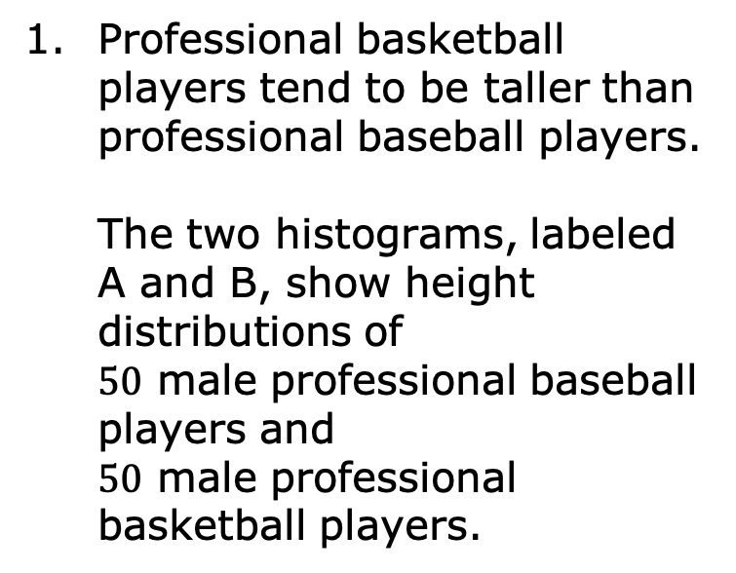
9.8.5 Wrap-Up: Ticket Out the Door
Professional basketball players tend to be taller than professional baseball players. The two histograms, labeled A and B, show height distributions of $50$ male professional baseball players and $50$ male professional basketball players.
A
B
Height (in inches)
volume 2, pg. 89

Slide 28
Choose one of the titles: “Heights of Baseball Players” or “Heights of Basketball Players” for each histogram.
Describe the spread and shape of the distribution of the heights of the basketball players.
Histogram | A | B
Best Title
volume 2, pg. 89

